Slide 1
Maximizing Outreach for the WTWY Gala
By: John Lassetter
Date: September 15th, 2021

Slide 2
Research Goal
WTWY: “Where we’d like to solicit your engagement is to use MTA subway data, which as I’m sure you know is available freely from the city, to help us optimize the placement of our street teams, such that we can gather the most signatures, ideally from those who will attend the gala and contribute to our cause.”
Actionable Goal – Find possible street team locations that see the most relevant foot traffic.
Simplification – Find subway stations with the most foot traffic and the times with the most foot traffic

Slide 3
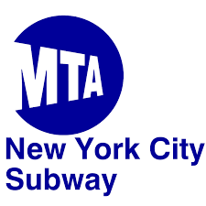
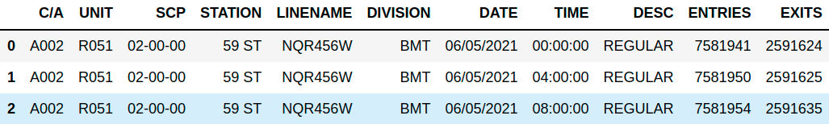
Data
MTA Data: http://web.mta.info/developers/turnstile.html
  C/A: Control area
  UNIT: Remote unit
  SCP: Sub-unit channel position
  Entries/Exits: Cumulative Entries/Exits recorded by turnstile at the time stamp
  Time interval queried: 06/04/2021 - 09/11/2021
  Ex.

Slide 4
Procedure
Compute (entries+exits)/hour → traffic/hour
Find busiest weekday
Find busiest time of day
Find busiest stations (on the busiest day/time)

Slide 5
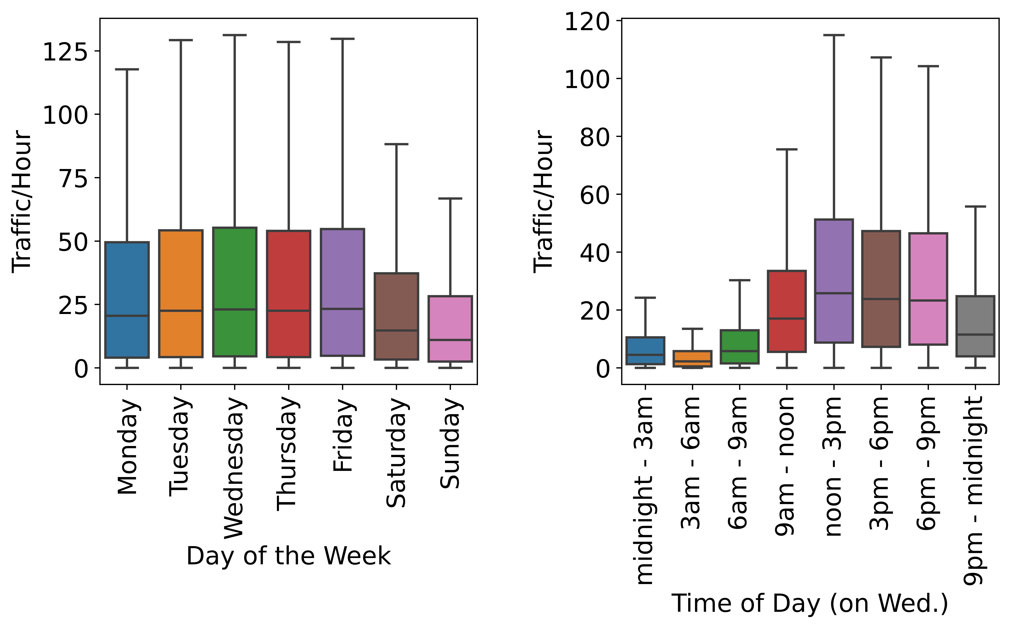
Busiest day of the week and time of the day
Takeaways:
Tues – Fri are the busiest days
12-9pm is the busiest time of the day

Slide 6
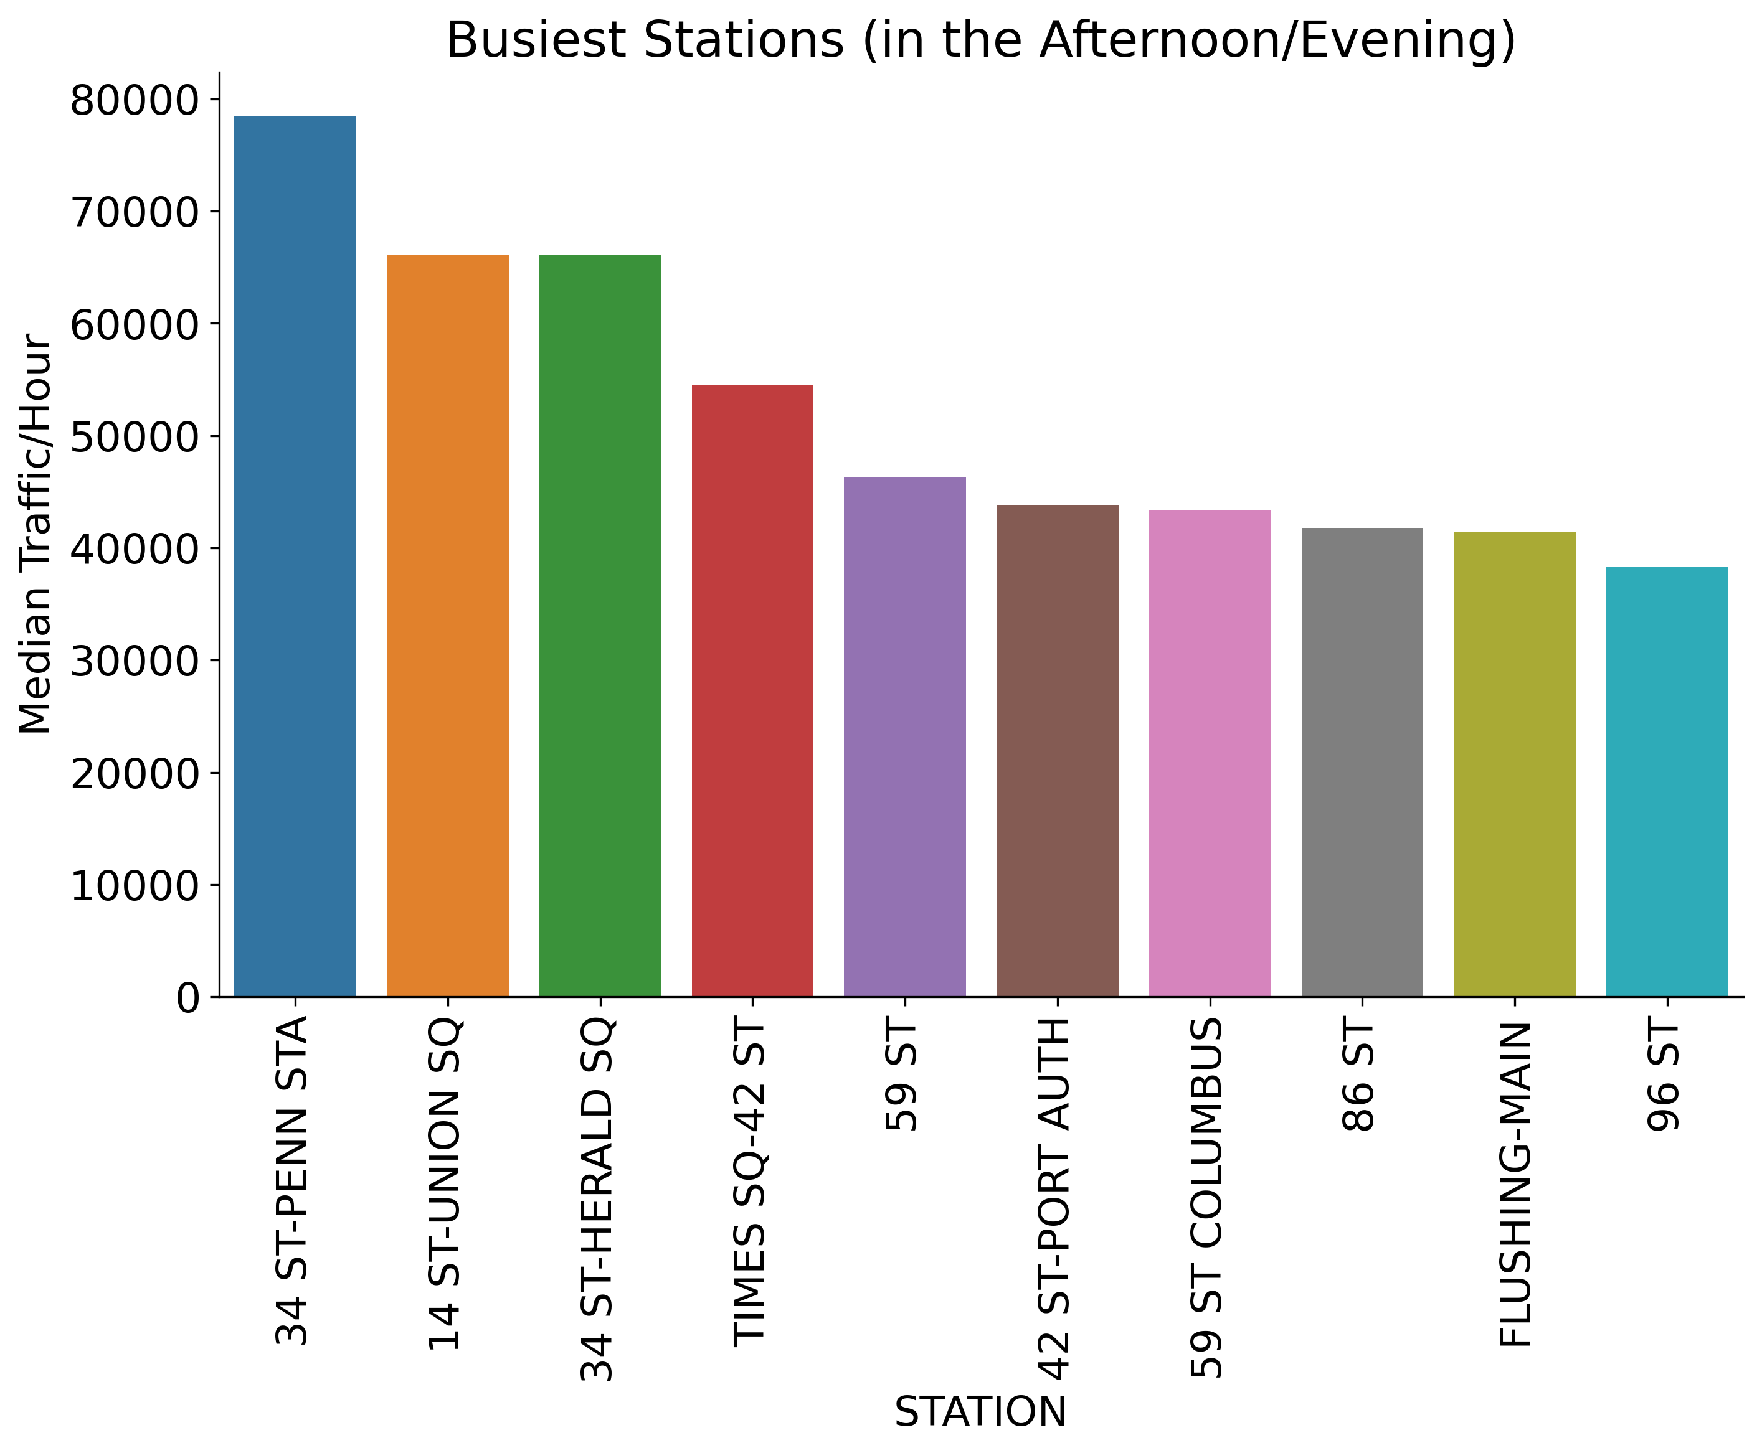
Results
Takeaways:
Best time: 2-6pm
Best days: Tues – Fri
Best Stations: →

Slide 7
Potential Improvements
Incorporate number of entrances per station
Incorporate subway lines to minimize double coverage of the same commuters

Slide 8
Questions?

Slide 9
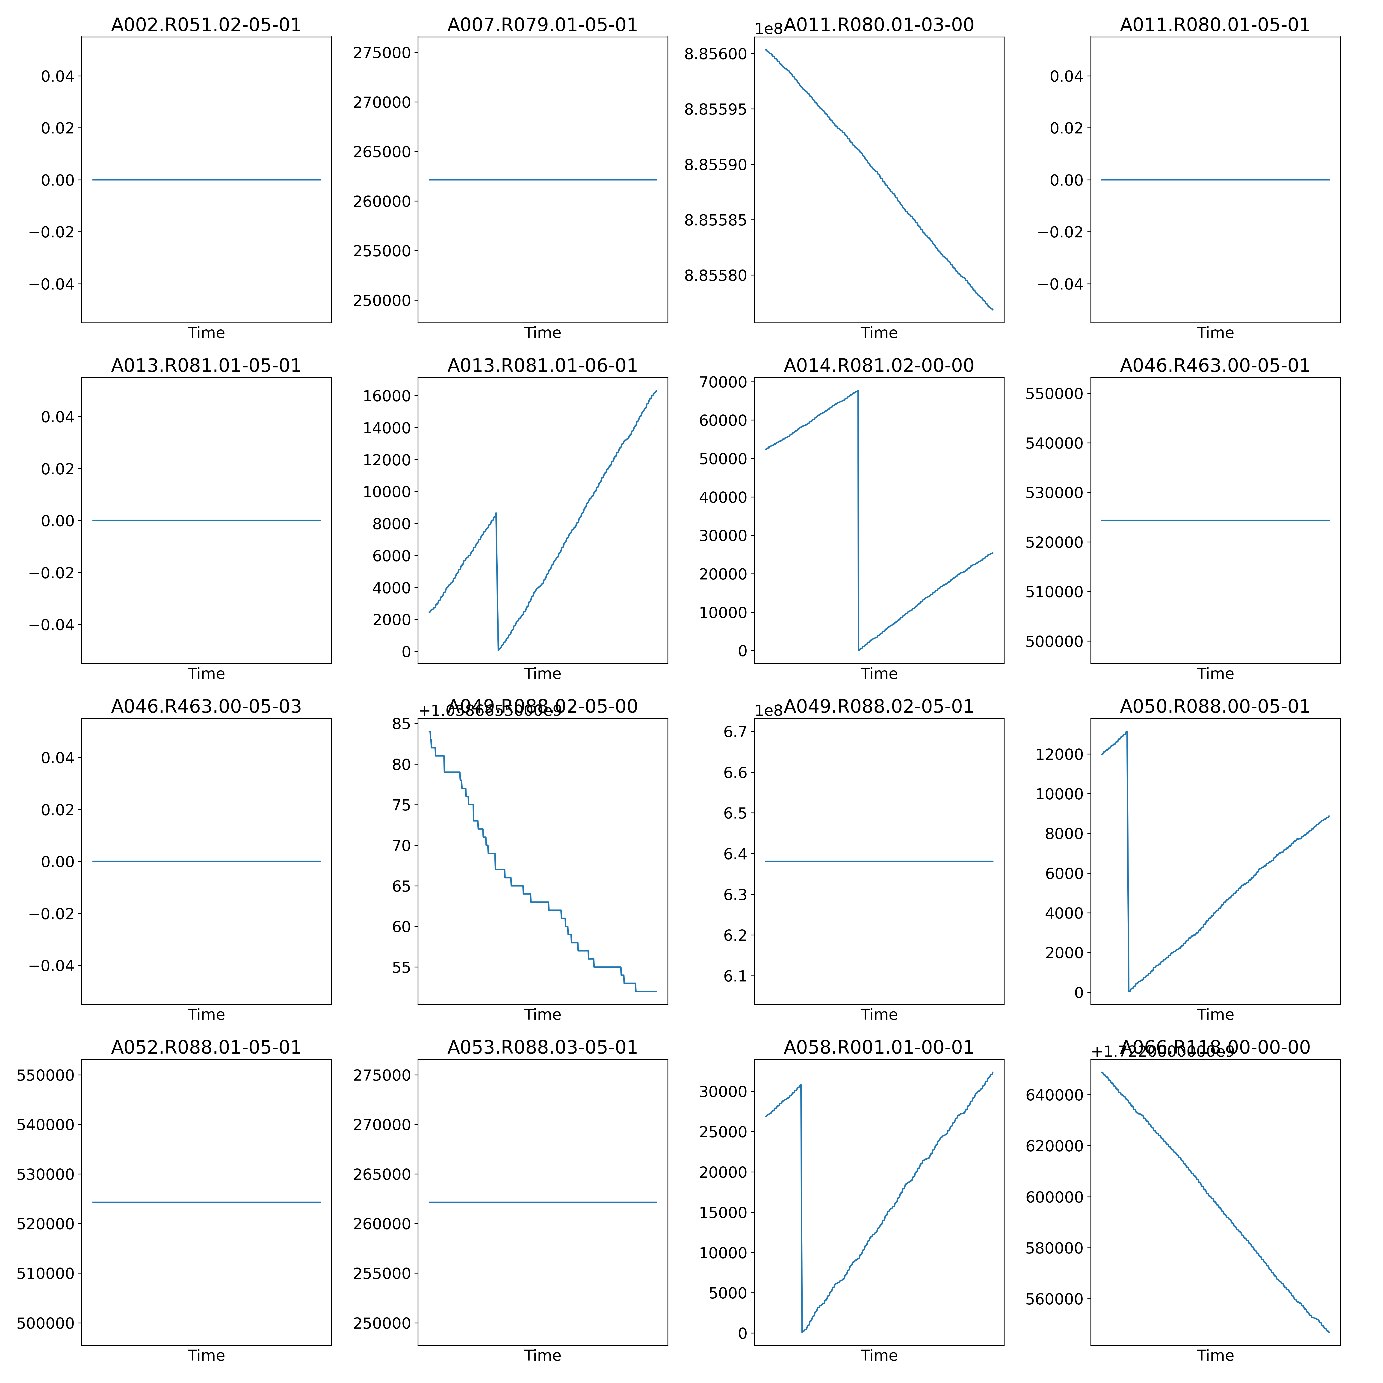
Appendix - Artifacts
Cumulative Entries vs. Time for “Bad” Turnstiles
Types of issues in Data
Broken turnstiles
Turnstile resets
Reversed Turnstiles

